Slide 1
Small Scale
Collaborative Trial
Ethephon
373

Slide 2
Catalog
01
Background
02
New method introduction
03
Single laboratory validation
04
Small scale trial results
05
Conclusion and recommendation

Slide 3
1. 1 General Information of Ethephon

Slide 4
1.2 Existing CIPAC Method-Titration(373/TK/M/- and 373/SL/M-)
The sample is neutralized to pH 9.3 to form the ethephon disodium salt, which is decomposed to ethene and sodium dihydrogen phosphate on heating. Sodium dihydrogen phosphate is determined by acidimetry.
(i) Formation of ethephon disodium salt
Cl-CH₂-CH₂-P(O)(OH)₂ + 2NaOH → Cl-CH₂-CH2-P(O)(ONa)₂ + 2H₂O
(ii) Thermal decomposition of ethephon disodium salt
Cl-CH₂-CH₂-P(O)(ONa)₂ + H₂O → CH₂=CH₂ + NaCl + (HO)₂P(O)(ONa)
(iii) Neutralisation of sodium dihydrogen phosphate
(HO)₂P(O)(ONa) + NaOH → (HO)-P(O)(ONa)₂ + H₂O
Advantages:
easy handling
cost effectiveness
Challenges:
Rely on person, less objective and stable
Non-specific

Slide 5
2.1 New method introduction-Ion Chromatography
Apparatus
Ethephon is determined by ion chromatography using electrolytic conductivity detector and external standardization. The analytical column used is based on alkanol quaternary ammonium.
Chromatographic conditions (typical)
Eluent: 7.2 mM Na₂CO₃ + 9.0 mM NaHCO₃
Flow rate: 1.0 mL/min
Current of inhibitor: 70 mA
Temperature of detector cell: 35℃
Temperature of column: 30℃
Mode of injection: PushFull
Volume of Injection: 25μL
Frequency of data sampling: 5.0 Hz
Run time: 13 min
Retention time: 9.5 min

Slide 6
2.2 Procedure
Preparation of Calibration sample. Prepare sample solutions in duplicate. Weigh (to the nearest 0.1 mg) sufficient sample (w mg) to contain about 120 mg of Ethephon into a brown volumetric flask (100 ml). Add ultrapure water to the mark and mix thoroughly. Transfer 5.00 mL of the above solution into a 50 mL volumetric flask, add ultrapure water to the mark and mix thoroughly. (Calibration solutions CA and CB).
Preparation of Ethephon sample. Prepare sample solutions in duplicate for each sample. Weigh (to the nearest 0.1 mg) sufficient sample (w mg) to contain about 120 mg of Ethephon into a brown volumetric flask (100 ml) (For TC samples, heat the sample in 95 ℃ water bath to melt and mix well before weighing ). Add ultrapure water to the mark and mix thoroughly. Transfer 5.00 mL of the above solution into a 50 mL volumetric flask, add ultrapure water to the mark and mix thoroughly. (Sample solutions S1 and S2).
Determination. Inject in duplicate 25 μl portions of each sample solution bracketing them by injections of the calibration solutions as follows: calibration solution CA, sample solution S1, sample solution S1, calibration solution CB, sample solution S2, sample solution S2, calibration solution CA, and so on. Measure the relevant peak areas.

Slide 7
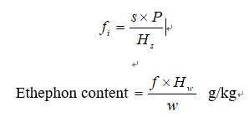
2.3 Calculation
Calculation. Determine the peak area of Ethephon and calculate the mean value of response factors from the calibration solutions bracketing the injections of the sample solutions and use this value for calculating the Ethephon content of the bracketed sample. The Ethephon content is the mean value of two sample solutions.
where:
fi = individual response factor
f = mean response factor of bracketing calibration injections
Hs = peak area of Ethephon in the calibration solution
Hw = peak area of Ethephon in the sample solution
s = mass of Ethephon reference standard in the calibration solution (mg)
w = mass of sample taken (mg)
P = purity of Ethephon reference standard (g/kg)

Slide 8
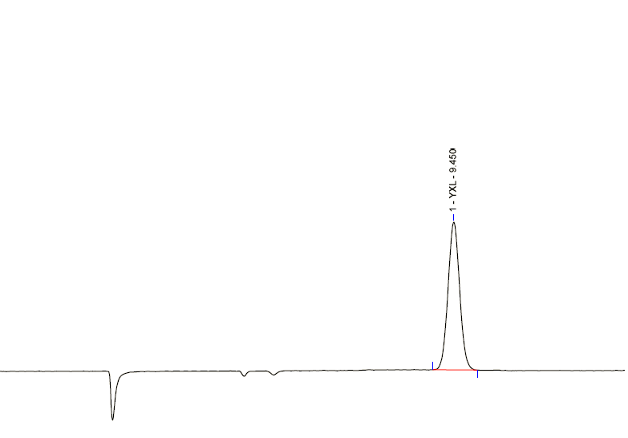
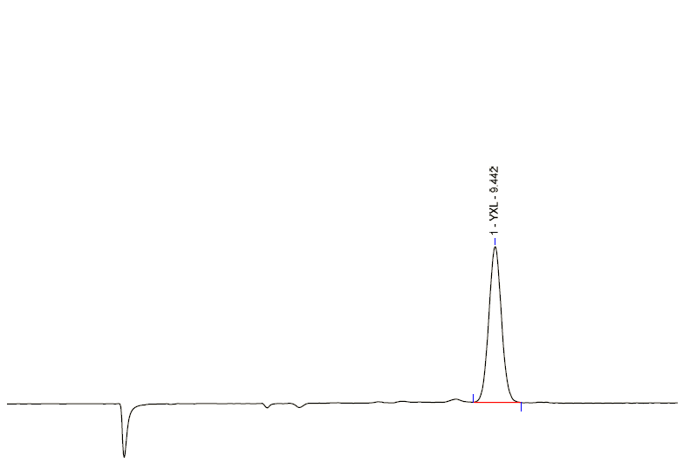
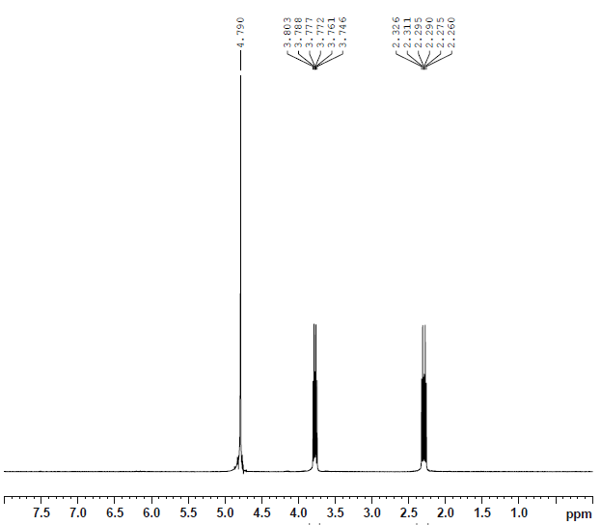
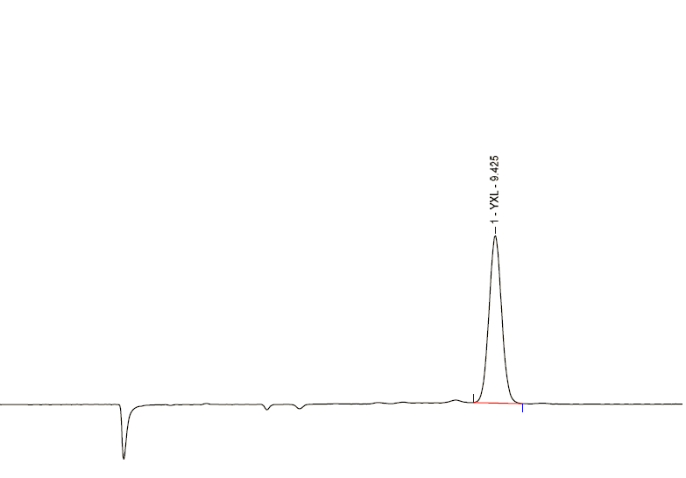
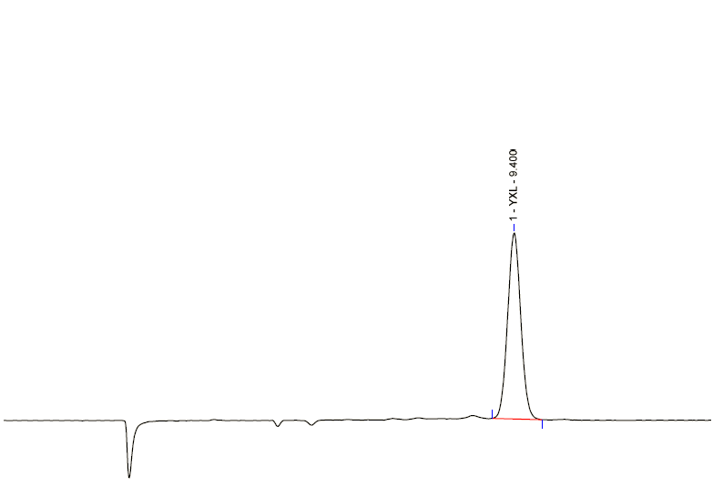
3. Single lab validation
Ion Chromatography Method
Typical chromatograms and spectrum
TC
SD
TK
SL
NMR
Fig.2 HPIC chromatogram of Ethephon standard

Slide 9
3.1 Linearity
Performing lab: BioGuide Technologies Co., Ltd.
Linearity range: 59.30-179.09 mg/L
R2=0.9992
Linearity of response

Slide 10
3.2 Precision
Precision test results for different samples
Sample | Content |  |  |  |  | Mean content g/kg | RSD %
 | 1 g/kg | 2 g/kg | 3 g/kg | 4 g/kg | 5 g/kg
TC | 931.2 | 937.4 | 937.6 | 940.8 | 936.6 | 936.7 | 0.47
TK | 759.0 | 758.6 | 759.5 | 760.3 | 764.4 | 760.4 | 0.45
SL | 412.7 | 419.1 | 420.1 | 417.4 | 411.2 | 416.1 | 0.94

Slide 11
3.3 Accuracy
Accuracy test results for different samples
Sample | Recovery |  |  |  | Mean recovery %
 | 1 % | 2 % | 3 % | 4 %
TC | 98.85 | 100.10 | 99.60 | 99.05 | 99.40
TK | 99.90 | 99.25 | 99.00 | 99.05 | 99.30
SL | 100.75 | 99.20 | 99.25 | 99.45 | 99.66

Slide 12
4. Small scale trial results
4.1 Participants
NAME | ORGANIZATION
Xiangdong SHAO | BioGuide Technologies Co., Ltd.
Chunqing HOU | SYRICI (Shenyang Research Institute of Chemical Industry)
Xiaoying JI | Eastlake Hi-Tech

Slide 13
4.2 Sample Information
Sample | Quantity | Batch | Declared Content of AI
ethephon TC1 | 50 g | E202011011 | Min. 93%
ethephon TC2 | 50 g | E202010030 | Min. 93%
ethephon TK1 | 50 mL | F202011011 | 75%
ethephon TK2 | 50 mL | F202010030 | 75%
ethephon SL1 | 50 mL | 2020110111 | 40%
ethephon SL2 | 50 mL | 2020100130 | 40%

Slide 14
4.3 Results – TC1
Table 1. Results of the analysis of AI content in the TC1
Lab | Day1(%) |  | Day2(%) |  | Average Yi(%) | Standard Deviation Si(%) | RSD(%)
 | 1 | 2 | 1 | 2
Lab1 | 93.32 | 93.38 | 93.25 | 93.20 | 93.29 | 0.0791 | 0.08
Lab2 | 94.22 | 94.02 | 93.88 | 93.94 | 94.01 | 0.1499 | 0.16
Lab3 | 94.02 | 94.54 | 93.86 | 94.31 | 94.18 | 0.3016 | 0.32

Slide 15
Results – TC2
Table 2. Results of the analysis of AI content in the TC2
Lab | Day1(%) |  | Day2(%) |  | Average Yi(%) | Standard Deviation Si(%) | RSD(%)
 | 1 | 2 | 1 | 2
Lab1 | 93.07 | 93.21 | 93.11 | 93.31 | 93.18 | 0.1091 | 0.12
Lab2 | 94.04 | 93.83 | 94.16 | 94.17 | 94.05 | 0.1587 | 0.17
Lab3 | 93.63 | 93.61 | 93.88 | 93.50 | 93.65 | 0.1609 | 0.17

Slide 16
Results – TK1
Table 3. Results of the analysis of AI content in the TK1
Lab | Day1(%) |  | Day2(%) |  | Average Yi(%) | Standard Deviation Si(%) | RSD(%)
 | 1 | 2 | 1 | 2
Lab1 | 76.47 | 77.55 | 76.17 | 76.65 | 76.71 | 0.5928 | 0.77
Lab2 | 76.24 | 75.82 | 75.51 | 76.01 | 75.90 | 0.3062 | 0.40
Lab3 | 75.99 | 76.20 | 76.01 | 76.03 | 76.06 | 0.0944 | 0.12

Slide 17
Results – TK2
Table 4. Results of the analysis of AI content in the TK2
Lab | Day1(%) |  | Day2(%) |  | Average Yi(%) | Standard Deviation Si(%) | RSD(%)
 | 1 | 2 | 1 | 2
Lab1 | 76.16 | 76.48 | 76.01 | 76.20 | 76.21 | 0.1940 | 0.25
Lab2 | 76.20 | 75.63 | 75.23 | 76.00 | 75.76 | 0.4268 | 0.56
Lab3 | 75.59 | 75.60 | 75.56 | 75.88 | 75.66 | 0.1503 | 0.20

Slide 18
Results – SL1
Table 5. Results of the analysis of AI content in the SL1
Lab | Day1(%) |  | Day2(%) |  | Average Yi(%) | Standard Deviation Si(%) | RSD(%)
 | 1 | 2 | 1 | 2
Lab1 | 41.18 | 41.28 | 41.28 | 41.14 | 41.22 | 0.0698 | 0.17
Lab2 | 41.74 | 41.65 | 41.22 | 40.84 | 41.36 | 0.4154 | 1.00
Lab3 | 40.80 | 40.43 | 41.01 | 41.10 | 40.84 | 0.3013 | 0.74

Slide 19
Results – SL2
Table 6. Results of the analysis of AI content in the SL2
Lab | Day1(%) |  | Day2(%) |  | Average Yi(%) | Standard Deviation Si(%) | RSD(%)
 | 1 | 2 | 1 | 2
Lab1 | 41.09 | 40.98 | 40.78 | 40.90 | 40.94 | 0.1351 | 0.33
Lab2 | 42.21 | 42.16 | 41.16 | 41.62 | 41.79 | 0.4960 | 1.19
Lab3 | 40.45 | 40.84 | 40.79 | 40.58 | 40.67 | 0.1811 | 0.45

Slide 20
Summary of the Statistic results of all laboratories
Table 7. Statistics of the results
 | TC1 | TC2 | TK1 | TK2 | SL1 | SL2
S₁=sum Yi | 280.88 | 281.49 | 228.66 | 227.63 | 123.42 | 123.39
S₂=sum Yi² | 26297.82845 | 26412.20202 | 17429.21017 | 17272.07366 | 5077.75606 | 5075.71446
S₃=sum Si² | 0.0630 | 0.1197 | 0.4541 | 0.2424 | 0.2682 | 0.2971
No. Lab, P | 3 | 3 | 3 | 3 | 3 | 3
No. Determination, n | 4 | 4 | 4 | 4 | 4 | 4
Average Y=S₁/P | 93.63 /936.3 | 93.83 /938.3 | 76.22 /762.2 | 75.88 /758.8 | 41.14 / 411.4 | 41.13 / 411.3
S_{r} | 0.1449 | 0.1997 | 0.3890 | 0.2843 | 0.2990 | 0.3147
S_{L} | 0.4309 | 0.4648 | 0.3864 | 0.2594 | 0.2273 | 0.5616
S_{R} | 0.4546 | 0.5059 | 0.5483 | 0.3848 | 0.3756 | 0.6438
r | 0.5593 / 5.593 | 0.4056 / 4.056 | 1.0893 / 10.893 | 0.7959 / 7.959 | 0.8371 / 8.371 | 0.8811 / 8.811
R | 1.4166 / 14.166 | 1.2729 / 12.729 | 1.5354 / 15.354 | 1.0774 / 10.774 | 1.0516 / 10.516 | 1.8025 / 18.025
RSD_{r} | 0.2129 | 0.1547 | 0.5104 | 0.3746 | 0.7267 | 0.7651
SD_{R} | 0.5392 | 0.4856 | 0.7194 | 0.5071 | 0.9129 | 1.5652
RSD_{R} (Hor) | 2.0193 | 2.0199 | 2.0834 | 2.0849 | 2.2861 | 2.2862
HorRat | 0.27 | 0.24 | 0.35 | 0.24 | 0.40 | 0.68

Slide 21
Statistical formulas
Where:
Yi = mean of the various laboratories
Si = standard deviation
P = number of laboratories
n = number of measurements ( here n=4 )
x = average, in unit of g/kg
c = the concentration of the analyte as a decimal fraction

Slide 22
4.4 Profits of ion chromatography method
Comparing with the existing titration method, ion chromatography method shows the following profits:
High sensitivity and visualizability
High reproducibility, and requiring less personal judgement and experience
High specificity

Slide 23
4.5 Comparison between existing and proposed methods
Results using existing and proposed methods for different samples
Sample | Existing Method | Proposed Method | SD | RSD (%)
TC1 | 930 | 937 | 4.95 | 0.53
TC2 | 931 | 941 | 7.07 | 0.76
TK1 | 755 | 757 | 1.41 | 0.19
TK2 | 756 | 761 | 3.54 | 0.47
SL1 | 403 | 407 | 2.83 | 0.70
SL2 | 404 | 408 | 2.83 | 0.70

Slide 24
5. Conclusion and recommendation
Conclusion:
For all samples, all values of RSD_{R} were less than the calculated Horwitz value, and most of the HorRat values were between 0.3 and 1, while 3 values were less than 0.3, but quite near.
Recommendation:
The method can be considered applicable to the determination of ethephon contents in TC, TK and SL.
We propose that a full scale collaborative trial will be conducted.

Slide 25
Thank you!
www.el-ht.com

